Slide 1
Recurrent Neural Networks (RNN) and Long-Short Term Memory(LSTM)

Slide 2
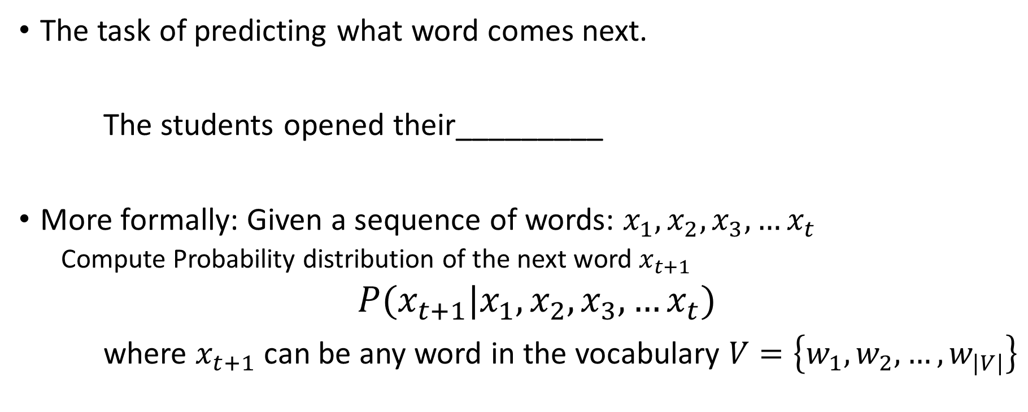
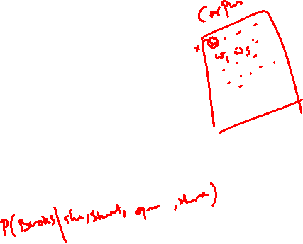
Recap…Language Modelling
The task of predicting what word comes next.
The students opened their_________
More formally: Given a sequence of words: $x_{1},x_{2},x_{3},…x_{t}$
Compute Probability distribution of the next word $x_{t+1}$
$P(x_{t+1}|x_{1},x_{2},x_{3},…x_{t})$
where $x_{t+1}$can be any word in the vocabulary $V=\left\{w_{1},w_{2},…,w_{|V|}\right\}$
Books/
Laptops/
Exams/…

Slide 3
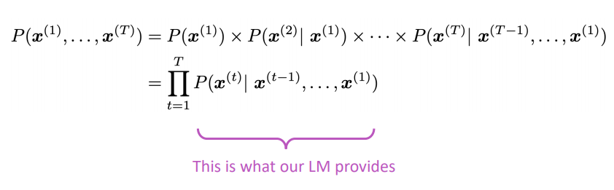
Language Modelling
You can also think of a Language Model as a system that assigns probability to a piece of text.
For example, if we have some text $x^{\left(1\right)},…,x^{\left(T\right)}$, then the probability of this text (according to the Language Model) is:

Slide 4
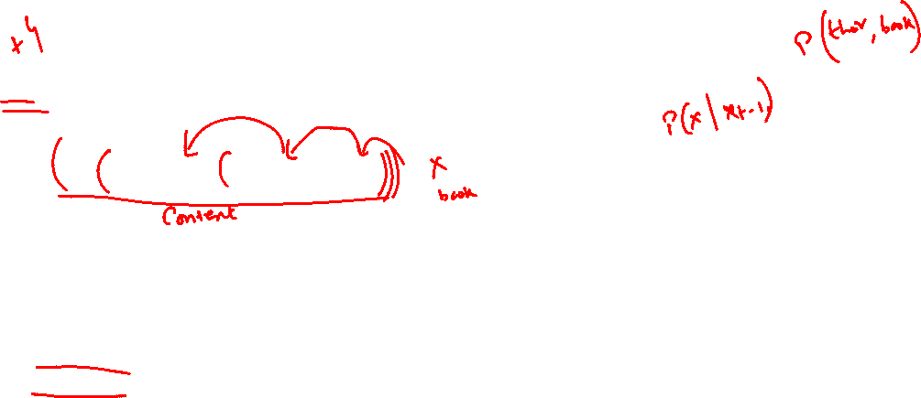
n-Gram Language Model
the students opened their ______
Question: How to learn a Language Model?
Answer (pre- Deep Learning): learn an n-gram Language Model!
Definition: A n-gram is a chunk of n consecutive words.
unigrams: “the”, “students”, “opened”, ”their”
bigrams: “the students”, “students opened”, “opened their”
trigrams: “the students opened”, “students opened their”
4-grams: “the students opened their”
Idea: Collect statistics about how frequent different n-grams are, and use these to predict next word.

Slide 5
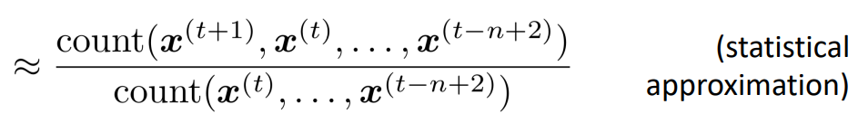
n-gram Language Models
First we make a Markov assumption: $x^{(t+1)}$depends only on the preceding n-1 words.
$$P\left(x^{\left(t+1\right)} | x^{\left(t\right)},…,x^{\left(t−n+2\right)}\right)=P(x^{\left(t+1\right)}, { x}^{\left(t\right)},… , { x}^{\left(t−n+2\right)})$$
$$=\frac{P(x^{\left(t+1\right)}, { x}^{\left(t\right)}, … , { x}^{\left(t−n+2\right)})}{P(x^{\left(t\right)}, … ,x^{\left(t−n+2\right)})}$$
Question: How do we get these n-gram and (n-1)-gram probabilities? Answer: By counting them in some large corpus of text!
prob of a n-gram
prob of a (n-1)-gram

Slide 6
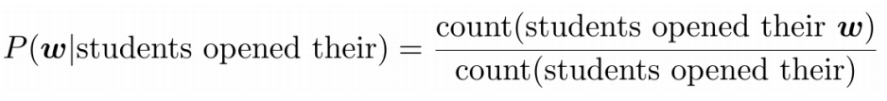
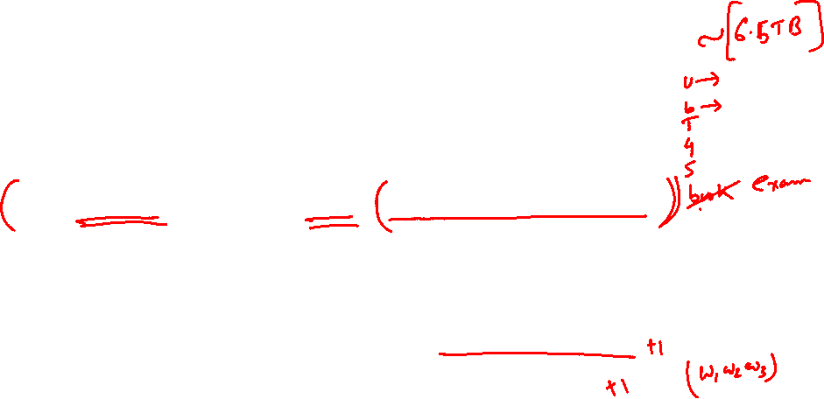
n-gram Language Models: Example
Suppose we are learning a 4-gram Language Model.
For example, suppose that in the corpus:
“students opened their” occurred 1000 times
“students opened their books” occurred 400 times
P(books | students opened their) = 0.4
“students opened their exams” occurred 100 times
P(exams | students opened their) = 0.1
as the proctor started the clock, the students opened their _____
discard
Condition on this
Was it a good idea to discard the proctor context?

Slide 7
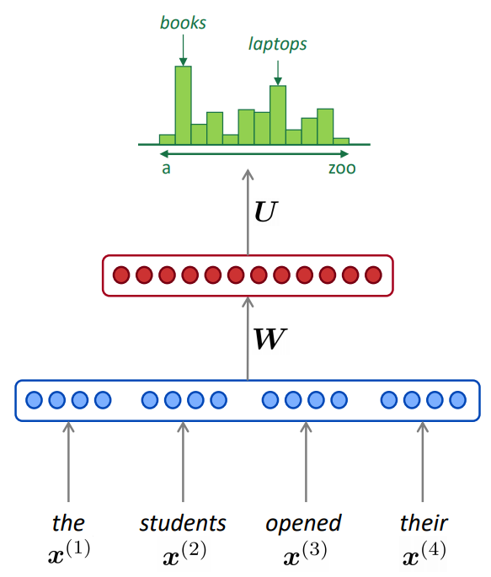






















Neural Language Model
Recall the Language Modeling task:
Input: sequence of words $x^{\left(1\right)},…,x^{\left(T\right)}$
Output: prob dist of the next word $P\left(x^{\left(t+1\right)} | x^{\left(t\right)},…,x^{\left(1\right)}\right)$
Window-based neural model
Linear Layer
$$w_{4}^{0}$$
$$w_{0}^{0}$$
$$w_{1}^{0}$$
$$w_{0}^{0}$$
$$w_{3}^{0}$$
$$w_{3}^{0}$$
$$w_{2}^{0}$$
$$w_{4}^{0}$$
$$w_{1}^{0}$$
$$w_{2}^{0}$$
$$w_{0}^{0}$$
$$w_{1}^{0}$$
$$w_{2}^{0}$$
$$w_{3}^{0}$$
$$w_{4}^{0}$$
$$e_{p}^{0}$$
$$e_{p}^{1}$$
$$e_{p}^{2}$$
$$e_{p}^{3}$$
$$e_{p}^{4}$$

Slide 8





Recurrent Neural Networks (RNN)
Core idea: Apply the same weights $W$ repeatedly
outputs (optional)
$${\hat{y}}^{\left(i\right)}$$
$$h^{\left(i\right)}$$
$$W$$
hidden states
input sequence (any length)
$$x^{\left(i\right)}$$

Slide 9






Recurrent Neural Networks (RNN)
Core idea: Apply the same weights $W$ repeatedly
outputs (optional)
$$Student$$
$$h^{\left(i\right)}$$
$$W$$
hidden states
input sequence (any length)
$$The$$

Slide 10



Recurrent Neural Networks (RNN)
Core idea: Apply the same weights $W$ repeatedly
outputs (optional)
$$Opened$$
$$h^{\left(i\right)}$$
$$W$$
hidden states
input sequence (any length)
$$Student$$

Slide 11


Recurrent Neural Networks (RNN)
Core idea: Apply the same weights $W$ repeatedly
outputs (optional)
$$book$$
$$h^{\left(i\right)}$$
$$W$$
hidden states
input sequence (any length)
$$Their$$

Slide 12

Recurrent Neural Networks (RNN)
Core idea: Apply the same weights $W$ repeatedly
outputs (optional)
$$student$$
$$h^{\left(i\right)}$$
$$W$$
hidden states
input sequence (any length)
$$The$$

Slide 13
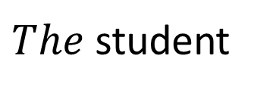

Recurrent Neural Networks (RNN)
Core idea: Apply the same weights $W$ repeatedly
outputs (optional)
$$opened$$
$$h^{\left(i\right)}$$
$$W$$
hidden states
input sequence (any length)
$The$ student

Slide 14


Recurrent Neural Networks (RNN)
Core idea: Apply the same weights $W$ repeatedly
outputs (optional)
$$their$$
$$h^{\left(i\right)}$$
$$W$$
hidden states
input sequence (any length)
$$The student opened$$

Slide 15
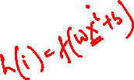
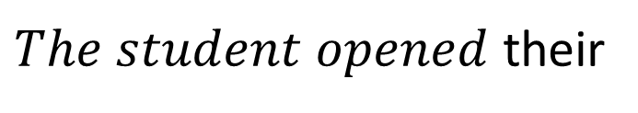
Recurrent Neural Networks (RNN)
Core idea: Apply the same weights $W$ repeatedly
outputs (optional)
$$book$$
$$h^{\left(i\right)}$$
$$W$$
hidden states
input sequence (any length)
$The$ $student opened$ their

Slide 16












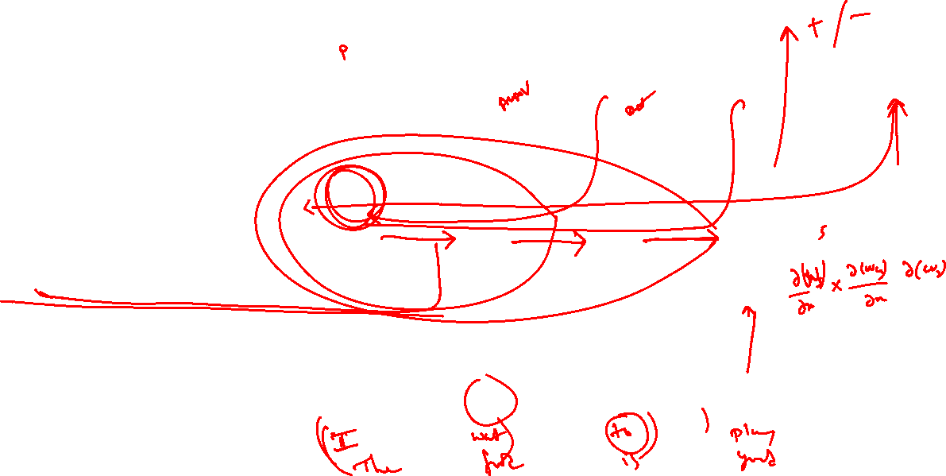



Recurrent Neural Networks (RNN)
Core idea: Apply the same weights $W$ repeatedly
$$…$$
outputs (optional)
$${\hat{y}}^{\left(1\right)}$$
$${\hat{y}}^{\left(2\right)}$$
$${\hat{y}}^{\left(3\right)}$$
$${\hat{y}}^{\left(4\right)}$$
$$h^{\left(1\right)}$$
$$h^{\left(2\right)}$$
$$h^{\left(3\right)}$$
$$h^{\left(4\right)}$$
W
W
W
W
hidden states
$$…$$
$$…$$
input sequence (any length)
$$x^{\left(1\right)}$$
$$x^{\left(2\right)}$$
$$x^{\left(3\right)}$$
$$x^{(4)}$$

Slide 17
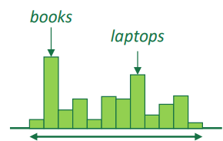
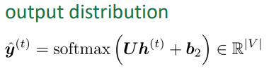
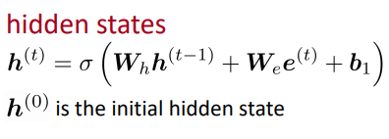

















A Simple RNN Language Model
$${\hat{y}}^{\left(4\right)}=P\left(x^{\left(5\right)}\right|The students opened their)$$
$$U$$
$$h^{\left(0\right)}$$
$$h^{\left(1\right)}$$
$$h^{\left(2\right)}$$
$$h^{\left(3\right)}$$
$$h^{\left(4\right)}$$
$$W_{h}$$
$$W_{h}$$
$$W_{h}$$
$$W_{h}$$
$$e^{\left(1\right)}$$
$$e^{\left(2\right)}$$
$$e^{\left(3\right)}$$
$$e^{(4)}$$
word embeddings
$$e^{\left(t\right)}$$
words
$$x^{\left(t\right)}$$
The students Opened Their

Slide 18



















A Simple RNN Language Model
$${\hat{y}}^{\left(4\right)}=P\left(x^{\left(5\right)}\right|The students opened their)$$
Advantages:
Can process any length input
Computation for step t can (in theory) use information from many steps back
Model size doesn’t increase for longer input
Same weights applied on every timestep, so there is symmetry in how inputs are processed.
$$U$$
$$h^{\left(0\right)}$$
$$h^{\left(1\right)}$$
$$h^{\left(2\right)}$$
$$h^{\left(3\right)}$$
$$h^{\left(4\right)}$$
$$W_{h}$$
$$W_{h}$$
$$W_{h}$$
$$W_{h}$$
$$W_{e}$$
$$W_{e}$$
$$W_{e}$$
$$W_{e}$$
Limitations:
Recurrent computation is slow
In practice, difficult to access information from many steps back
$$e^{\left(1\right)}$$
$$e^{\left(2\right)}$$
$$e^{\left(3\right)}$$
$$e^{(4)}$$
The students Opened Their

Slide 19
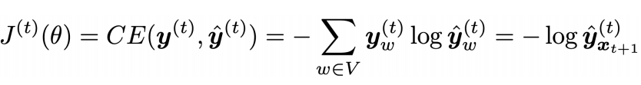
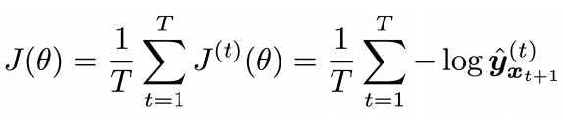
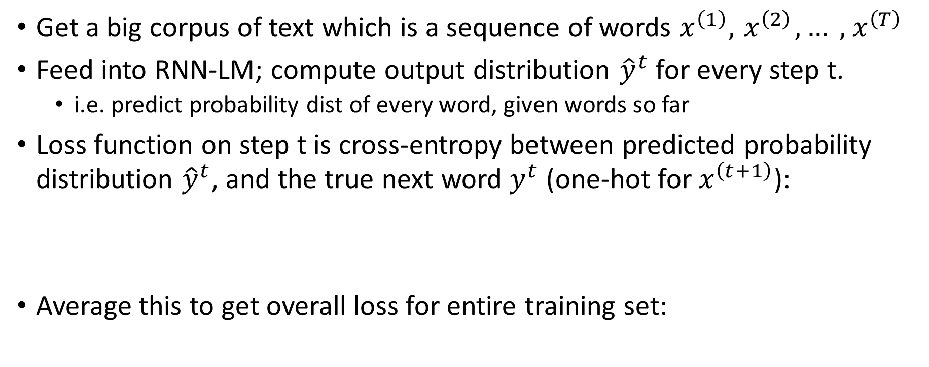
Training an RNN Language Model
Get a big corpus of text which is a sequence of words $x^{\left(1\right)}, { x}^{\left(2\right)},… , { x}^{\left(T\right)}$
Feed into RNN-LM; compute output distribution ${\hat{y}}^{t}$ for every step t.
i.e. predict probability dist of every word, given words so far
Loss function on step t is cross-entropy between predicted probability distribution ${\hat{y}}^{t}$, and the true next word $y^{t}$ (one-hot for $x^{\left(t+1\right)}$):
Average this to get overall loss for entire training set:

Slide 20
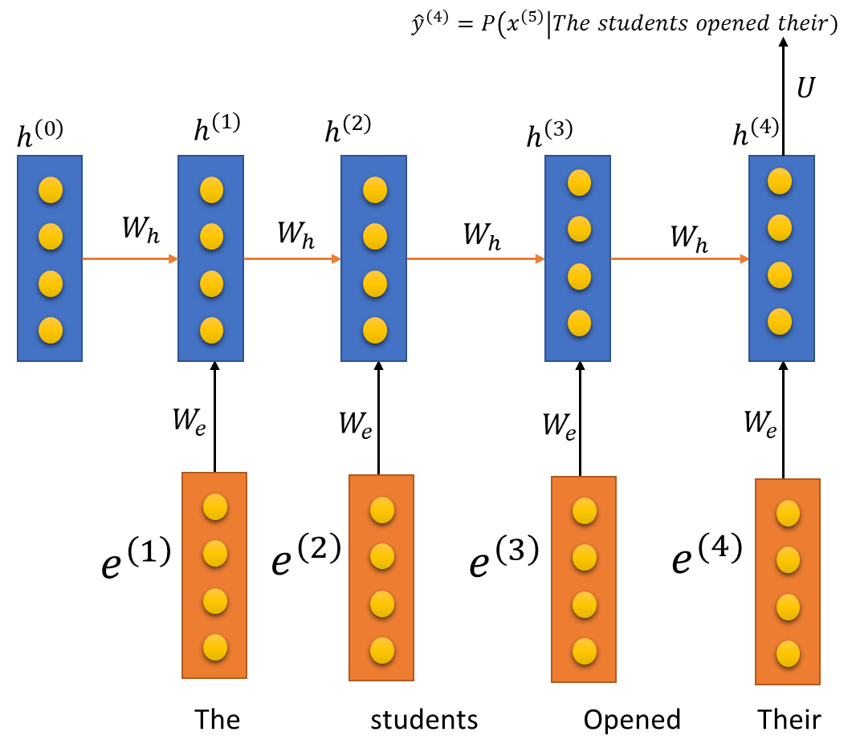

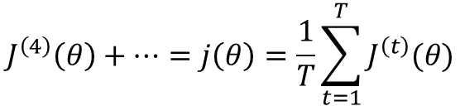
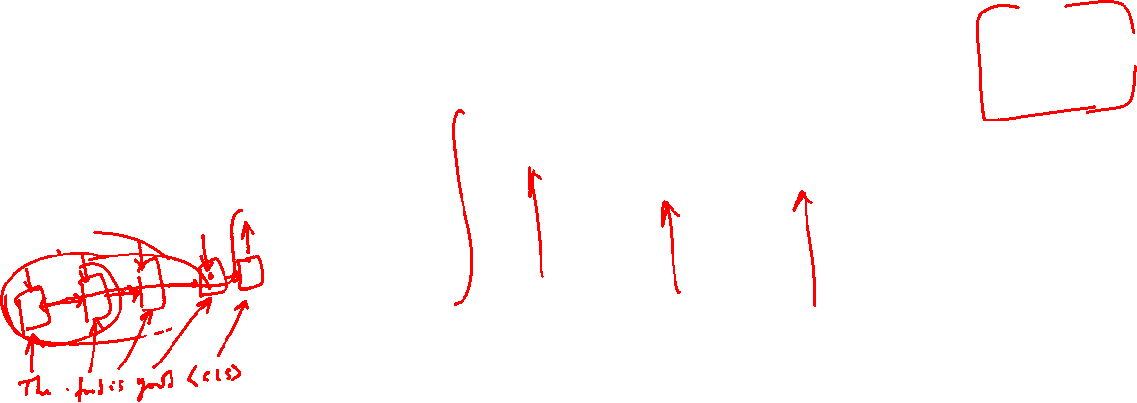










Training an RNN-Language Model
= negative log prob of “students”
= negative log prob of “opened”
= negative log prob of “their”
= negative log prob of “exam”
$$J^{\left(4\right)}\left(θ\right)+…=j\left(θ\right)=\frac{1}{T}\sum_{t=1}^{T}{J^{\left(t\right)}(θ)}$$
Loss
$$J^{(1)} \left(θ\right)+$$
$$J^{\left(2\right)}\left(θ\right)+$$
$$J^{\left(3\right)}\left(θ\right)+$$
Predicted prob dists
$${\hat{y}}^{(1)}$$
$${\hat{y}}^{(2)}$$
$${\hat{y}}^{(3)}$$
$${\hat{y}}^{(4)}$$
…
$$U$$
“Teacher forcing”
$$U$$
$$U$$
$$W_{h}$$
…
…
Corpus

Slide 21


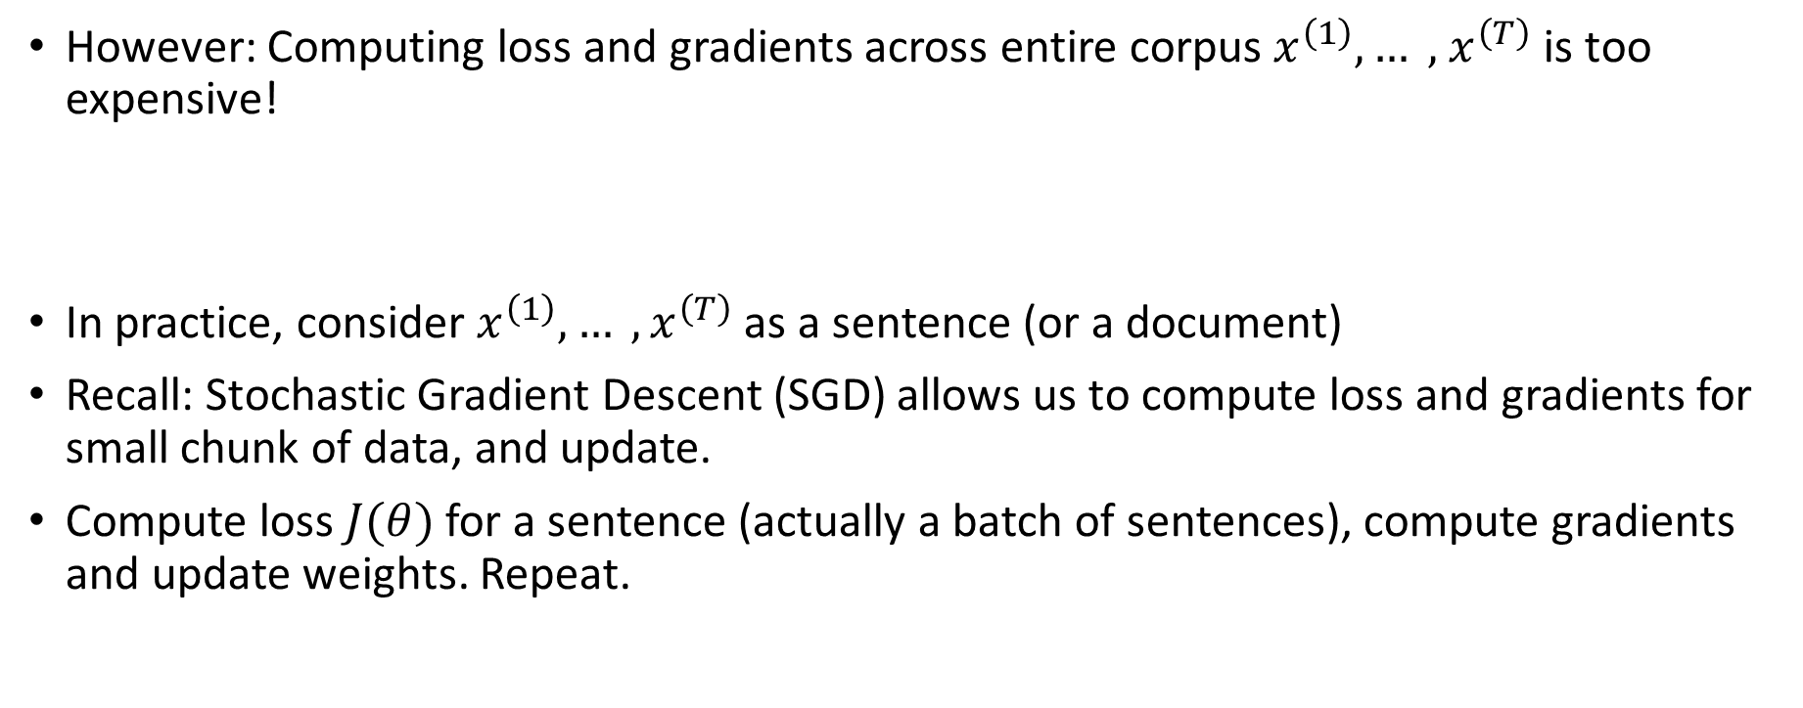
Training a RNN Language Model
However: Computing loss and gradients across entire corpus $x^{\left(1\right)},… , { x}^{\left(T\right)}$ is too expensive!
In practice, consider $x^{\left(1\right)},… , x^{\left(T\right)}$as a sentence (or a document)
Recall: Stochastic Gradient Descent (SGD) allows us to compute loss and gradients for small chunk of data, and update.
Compute loss $J(θ)$ for a sentence (actually a batch of sentences), compute gradients and update weights. Repeat.
$$j\left(θ\right)=\frac{1}{T}\sum_{t=1}^{T}{J^{\left(t\right)}(θ)}$$

Slide 22
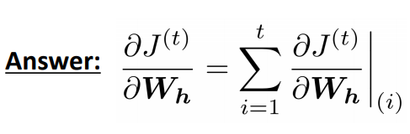

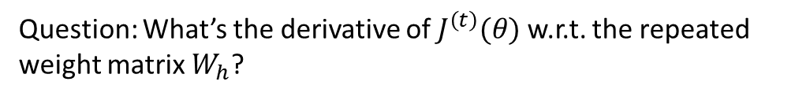






Backpropagation for RNNs
Question: What’s the derivative of $J^{\left(t\right)}(θ)$w.r.t. the repeated weight matrix $W_{h}$?
$$J^{\left(t\right)}(θ)$$
$$h^{\left(0\right)}$$
$$h^{\left(t−2\right)}$$
$$h^{\left(t−1\right)}$$
$$h^{\left(t\right)}$$
W
W
W
W
$$…$$
“The gradient w.r.t. a repeated weight is the sum of the gradient w.r.t. each time it appears”
$$…$$
$$x^{\left(1\right)}$$
$$x^{\left(2\right)}$$
$$x^{\left(3\right)}$$
$$x^{(4)}$$

Slide 23











Backpropagation for RNNs
Backpropagate over timesteps i= t,…,0 summing gradients as you go.
This algorithm is called “backpropagation through time”
$$J^{\left(t\right)}(θ)$$
$$h^{\left(0\right)}$$
$$h^{\left(t−2\right)}$$
$$h^{\left(t−1\right)}$$
$$h^{\left(t\right)}$$
W
W
W
W
$$…$$
$$…$$
$$x^{\left(1\right)}$$
$$x^{\left(2\right)}$$
$$x^{\left(3\right)}$$
$$x^{(4)}$$

Slide 24
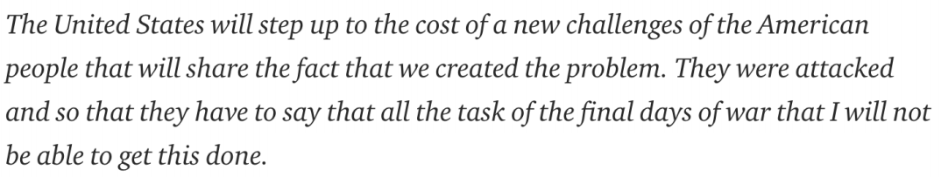
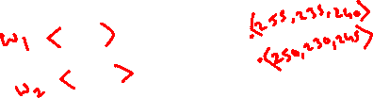
Some Results
You can train a RNN-LM on any kind of text, then generate text in that style.
RNN-LM trained on Obama speeches:
Source: https://medium.com/@samim/obama-rnn-machine-generated-political-speeches-c8abd18a2ea0

Slide 25
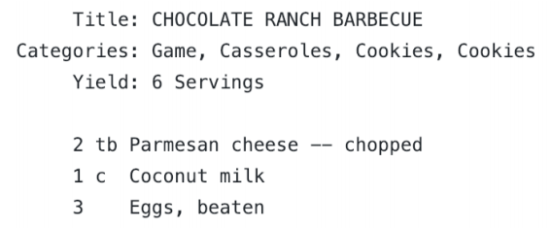
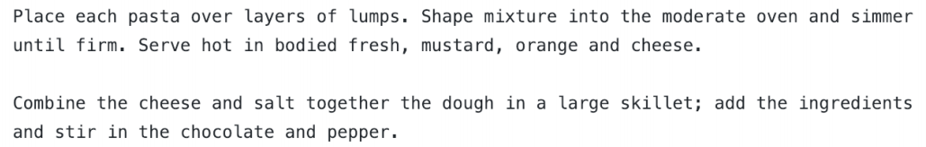
Some Results
You can train a RNN-LM on any kind of text, then generate text in that style.
RNN-LM trained on recipes:
Source: https://gist.github.com/nylki/1efbaa36635956d35bcc

Slide 26
Vanishing Gradient

Slide 27
Vanishing gradient intuition
$$J^{\left(t\right)}(θ)$$
$$h^{\left(0\right)}$$
$$h^{\left(t−2\right)}$$
$$h^{\left(t−1\right)}$$
$$h^{\left(t\right)}$$
W
W
W
W
$$…$$
$$…$$
$$x^{\left(1\right)}$$
$$x^{\left(2\right)}$$
$$x^{\left(3\right)}$$
$$x^{(4)}$$

Slide 28

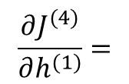
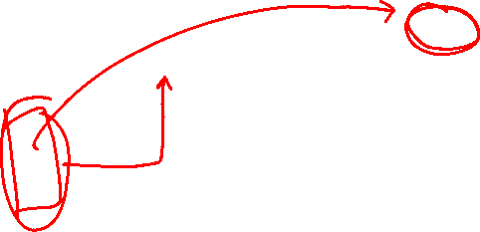




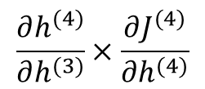



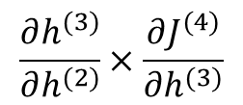



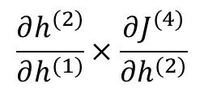
Vanishing gradient intuition
$$J^{\left(t\right)}(θ)$$
$$h^{\left(0\right)}$$
$$h^{\left(t−2\right)}$$
$$h^{\left(t−1\right)}$$
$$h^{\left(t\right)}$$
W
W
W
W
$$…$$
$$x^{\left(1\right)}$$
$$x^{\left(2\right)}$$
$$x^{\left(3\right)}$$
$$x^{(4)}$$
$$…$$
$$\frac{∂J^{(4)}}{∂h^{(1)}}=$$
$$\frac{∂h^{(2)}}{∂h^{(1)}}×\frac{∂J^{(4)}}{∂h^{(2)}}$$
$$\frac{∂h^{(3)}}{∂h^{(2)}}×\frac{∂J^{(4)}}{∂h^{(3)}}$$
$$\frac{∂h^{(4)}}{∂h^{(3)}}×\frac{∂J^{(4)}}{∂h^{(4)}}$$
Chain Rule

Slide 29
Vanishing gradient intuition
$$J^{\left(t\right)}(θ)$$
What happens if these are small?
$$h^{\left(0\right)}$$
$$h^{\left(t−2\right)}$$
$$h^{\left(t−1\right)}$$
$$h^{\left(t\right)}$$
W
W
W
W
$$…$$
Vanishing gradient problem:
When these are small, the gradient signal gets smaller and smaller as it backpropagates further
$$x^{\left(1\right)}$$
$$x^{\left(2\right)}$$
$$x^{\left(3\right)}$$
$$x^{(4)}$$
$$…$$
$$\frac{∂J^{(4)}}{∂h^{(1)}}=$$
$$\frac{∂h^{(2)}}{∂h^{(1)}}×\frac{∂J^{(4)}}{∂h^{(2)}}$$
$$\frac{∂h^{(3)}}{∂h^{(2)}}×\frac{∂J^{(4)}}{∂h^{(3)}}$$
$$\frac{∂h^{(4)}}{∂h^{(3)}}×\frac{∂J^{(4)}}{∂h^{(4)}}$$
Chain Rule

Slide 30


Why is vanishing gradient a problem?
Vanishing gradient problem:
When these are small, the gradient signal gets smaller and smaller as it backpropagates further
$$J^{\left(t−k\right)}(θ)$$
$$J^{\left(t\right)}(θ)$$
$$h^{\left(0\right)}$$
$$h^{\left(t−2\right)}$$
$$h^{\left(t−1\right)}$$
$$h^{\left(t\right)}$$
W
W
W
W
$$…$$
$$x^{\left(1\right)}$$
$$x^{\left(2\right)}$$
$$x^{\left(3\right)}$$
$$x^{(4)}$$
$$…$$
Gradient signal from faraway is lost because it’s much smaller than gradient signal from close-by.
So model weights are updated only with respect to near effects, not long-term effects.

Slide 31
Why is vanishing gradient a problem?
Gradient can be viewed as a measure of the effect of the past on the future
If the gradient becomes vanishingly small over longer distances (step t to step t+n), then we can’t tell whether:
There’s no dependency between step t and t+n in the data
We have wrong parameters to capture the true dependency between t and t+n

Slide 32
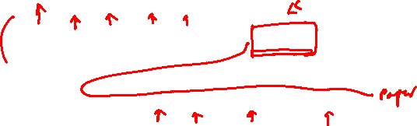
Effect of vanishing gradient on RNN-LM
LM task: When she tried to print her tickets, she found that the printer was out of toner. She went to the stationery store to buy more toner. It was very overpriced. After installing the toner into the printer, she finally printed her ________
To learn from this training example, the RNN-LM needs to model the dependency between “tickets” on the 7th step and the target word “tickets” at the end.
But if gradient is small, the model can’t learn this dependency • So the model is unable to predict similar long-distance dependencies at test time

Slide 33

Effect of vanishing gradient on RNN-LM
LM task: The writer of the books ____ is or are
Sequential recency: The writer of the books are
Syntactic recency: The writer of the books is
Vanishing gradient problems may bias RNN-LMs towards learning from sequential recency, so they make this type of error more often than we’d like. [Linzen et al 2016]

Slide 34
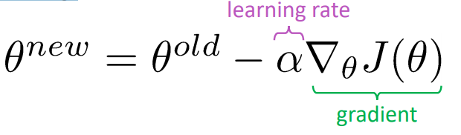
Why is exploding gradient a problem?
If the gradient becomes too big, then the SGD update step becomes too big:
This can cause bad updates: we take too large a step and reach a bad parameter configuration (with large loss)
In the worst case, this will result in Inf or NaN in your network (then you have to restart training from an earlier checkpoint)

Slide 35
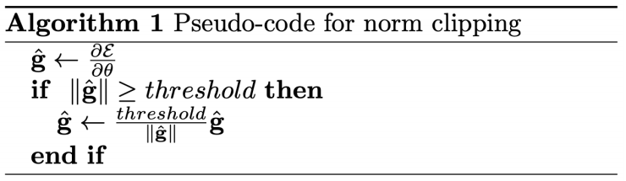
Solution: Gradient clipping
Gradient clipping: if the norm of the gradient is greater than some threshold, scale it down before applying SGD update
Idea: take a step in the same direction, but a smaller step

Slide 36
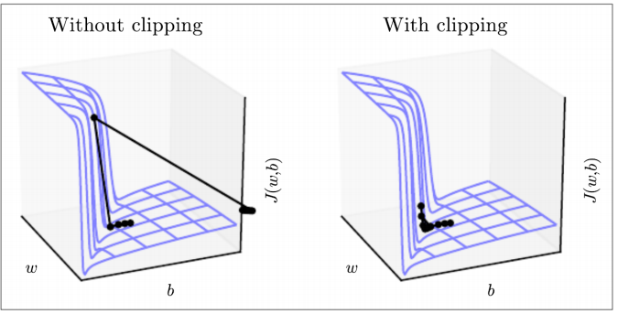
Gradient clipping
This shows the loss surface of a simple RNN (hidden state is a scalar not a vector)
The “cliff” is dangerous because it has steep gradient
On the left, gradient descent takes two very big steps due to steep gradient, resulting in climbing the cliff then shooting off to the right (both bad updates)
On the right, gradient clipping reduces the size of those steps, so effect is less drastic

Slide 37
How to fix vanishing gradient problem?
The main problem is that it’s too difficult for the RNN to learn to preserve information over many timesteps
In a vanilla RNN, the hidden state is constantly being rewritten
How about a RNN with separate memory?

Slide 38
Gated Recurrent Unit (GRU)

Slide 39
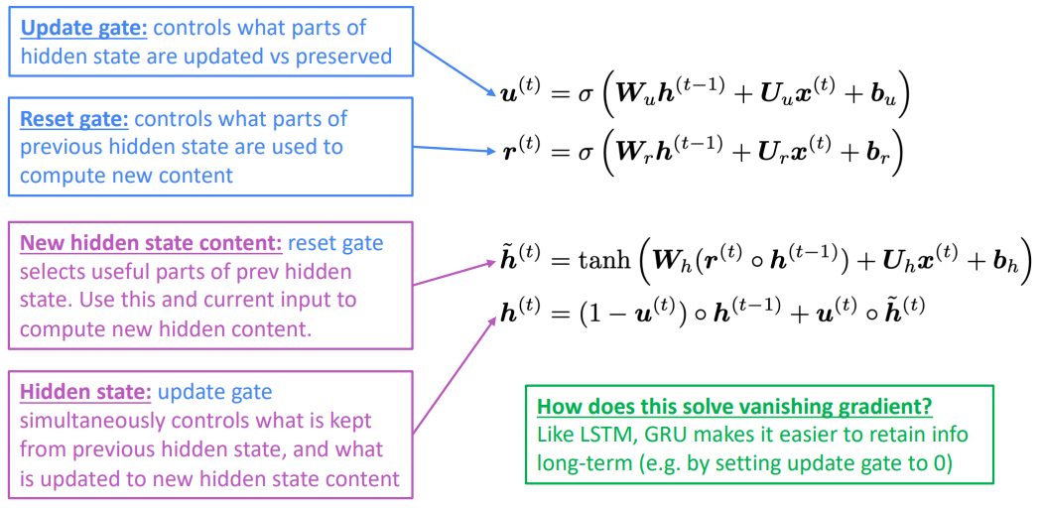
Gated Recurrent Units (GRU)
Proposed by Cho et al. in 2014 as a simpler alternative to the LSTM.
On each timestep t we have input and hidden state (no cell state).

Slide 40
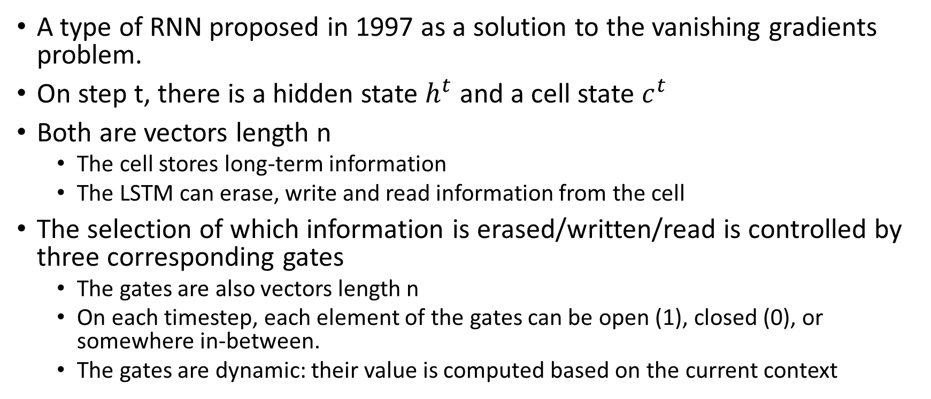
Long Short-Term Memory (LSTM)
A type of RNN proposed in 1997 as a solution to the vanishing gradients problem.
On step t, there is a hidden state $h^{t}$ and a cell state $c^{t}$
Both are vectors length n
The cell stores long-term information
The LSTM can erase, write and read information from the cell
The selection of which information is erased/written/read is controlled by three corresponding gates
The gates are also vectors length n
On each timestep, each element of the gates can be open (1), closed (0), or somewhere in-between.
The gates are dynamic: their value is computed based on the current context

Slide 41






LSTM Intuition
$$…$$
outputs (optional)
$${\hat{y}}^{\left(1\right)}$$
$${\hat{y}}^{\left(2\right)}$$
$${\hat{y}}^{\left(3\right)}$$
$${\hat{y}}^{\left(4\right)}$$
$$h^{\left(0\right)}$$
W
$$h^{\left(2\right)}$$
W
$$h^{\left(3\right)}$$
W
$$h^{\left(4\right)}$$
W
hidden states
$$…$$
$$…$$
input sequence (any length)
$$x^{\left(1\right)}$$
$$x^{\left(2\right)}$$
$$x^{\left(3\right)}$$
$$x^{(4)}$$

Slide 42
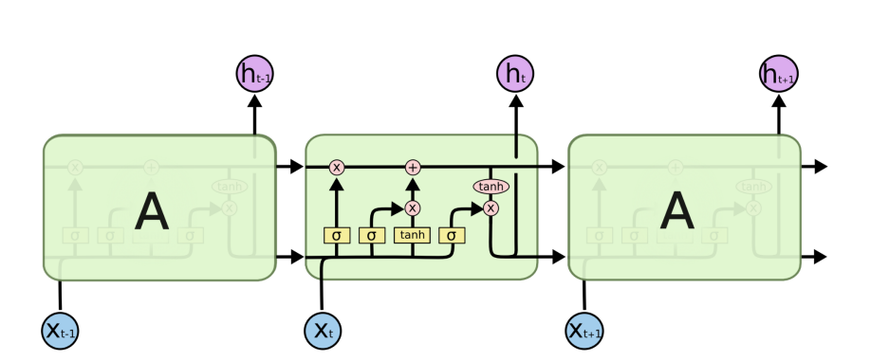
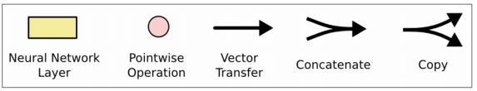
Long Short-Term Memory (LSTM)
You can think of the LSTM equations visually like this:

Slide 43
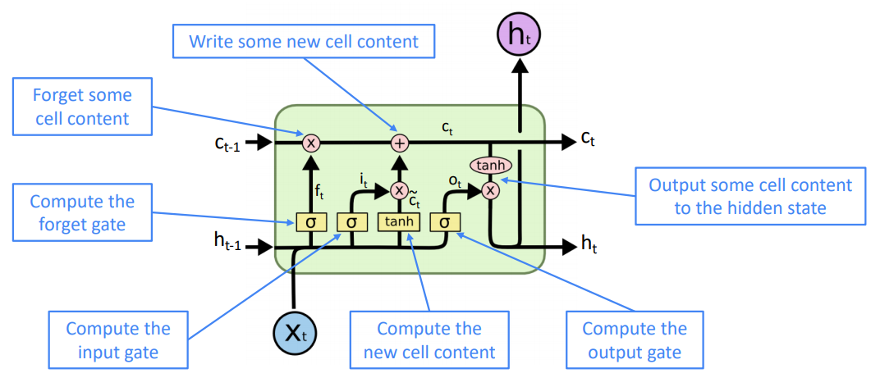
Long Short-Term Memory (LSTM)

Slide 44
How does LSTM solve vanishing gradients?
The LSTM architecture makes it easier for the RNN to preserve information over many timesteps
e.g. if the forget gate is set to 1 for a cell dimension and the input gate set to 0, then the information of that cell is preserved indefinitely.
By contrast, it’s harder for vanilla RNN to learn a recurrent weight matrix Wh that preserves info in hidden state
LSTM doesn’t guarantee that there is no vanishing/exploding gradient, but it does provide an easier way for the model to learn long-distance dependencies

Slide 45
LSTM vs GRU
Researchers have proposed many gated RNN variants, but LSTM and GRU are the most widely-used
Rule of thumb: LSTM is a good default choice (especially if your data has particularly long dependencies, or you have lots of training data); Switch to GRUs for speed and fewer parameters.

Slide 46
Is vanishing/exploding gradient just a RNN problem?
No! It can be a problem for all neural architectures (including feed-forward and convolutional), especially deep ones.
Due to chain rule / choice of nonlinearity function, gradient can become vanishingly small as it backpropagates
Thus lower layers are learnt very slowly (hard to train)
Solution: lots of new deep feedforward/convolutional architectures that add more direct connections (thus allowing the gradient to flow)

Slide 47
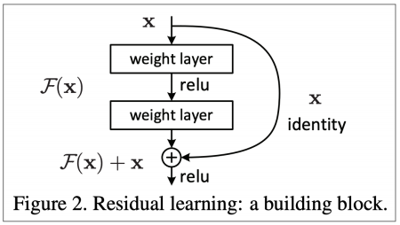
Is vanishing/exploding gradient just a RNN problem?
Residual connections aka “ResNet”
Also known as skip-connections
The identity connection preserves information by default
This makes deep networks much easier to train

Slide 48
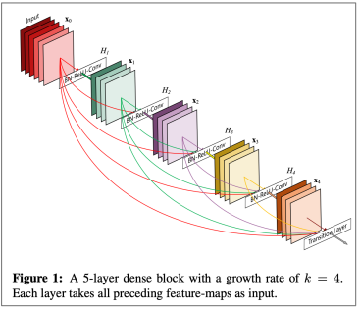
Is vanishing/exploding gradient just a RNN problem?
Dense connections aka “DenseNet”
Directly connect each layer to all future layers!
Highway connections aka “HighwayNet”
Similar to residual connections, but the identity connection vs the transformation layer is controlled by a dynamic gate
Inspired by LSTMs, but applied to deep feedforward/convolutional networks

Slide 49
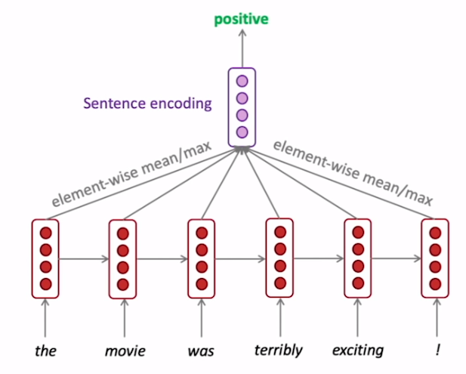
Bi-Directional RNN
We can regard this hidden state as a representation of the word “terribly” in the context of this sentence. We call this a contextual representation.
These contextual representations only contain information about the left context (e.g. “the movie was”).
What about right context?
In this example, “exciting” is in the right context and this modifies the meaning of “terribly” (from negative to positive)

Slide 50
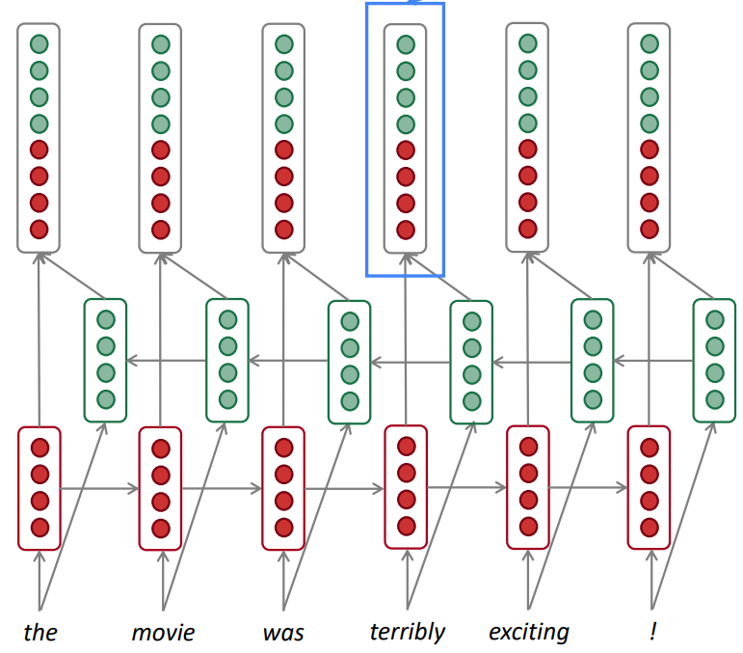
Bi-Directional RNN
Concatenated hidden states
This contextual representation of “terribly” has both left and right context!
Backward RNN
Forward RNN

Slide 51
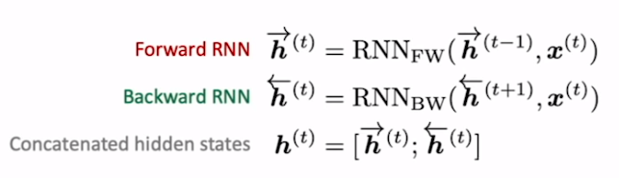
Bidirectional RNNs
This is a general notation to mean “compute one forward step of the RNN” – it could be a vanilla, LSTM or GRU computation.
On timestep t:
Generally, these two RNNs have separate weights
We regard this as “the hidden state” of a bidirectional RNN. This is what we pass on to the next parts of the network.

Slide 52
Bidirectional RNNs
Only applicable if you have access to the entire input sequence.
They are not applicable to Language Modeling, because in LM you only have left context available.
If you do have entire input sequence (e.g. any kind of encoding), bidirectionality is powerful (you should use it by default).
For example, BERT (Bidirectional Encoder Representations from Transformers) is a powerful pretrained contextual representation system built on bidirectionality. • You will learn more about BERT later in the course!

Slide 53
Multi-layer RNNs
RNNs are already “deep” on one dimension (they unroll over many timesteps)
We can also make them “deep” in another dimension by applying multiple RNNs – this is a multi-layer RNN.
This allows the network to compute more complex representations
The lower RNNs should compute lower-level features and the higher RNNs should compute higher-level features.
Multi-layer RNNs are also called stacked RNNs.

Slide 54

Multi-layer RNNs
The hidden states from RNN layer i are the inputs to RNN layer i+1

Slide 55

Types of RNN

